Slide 1
E SPORTS LOGIN AND REGISTRATION MODULE
L.Nagur Reddy
192011136
CSE DEPARTMENT
Subject: Software Testing
Faculty Dr.GURURAMA SENTHIL.P

Slide 2

AIM:-
To Verify The Login and Registration module in e sports

Slide 3
Esports is a form of competition using video games. Esports often takes the form of organized, multiplayer video game competitions, particularly between professional players, individually or as teams

Slide 4
REGISTER MODULE REQUIREMENTS
FirstName LastName Address UserName PhoneNumber Email ID Gender Password
Confirm Password

Slide 5
TEST CASES FOR LOGIN AND REGISTRATION
S NO | TEST CASES | PASS/FAIL
1 | Verify the user can register with face book account | pass
2 | Verify the user can register with google play account | pass
3 | Verify the user can log in with a different account. | fail
4 | Verify the user can log in as a guest Account | pass
5 | Verify the user can log in with out internet | fail
6 | Verify the user password is incorrectly entered | fail
7 | Verify the user can log in any other device | pass

Slide 6
TEST SCENARIOS
Verify if the user cannot proceed without filling all the mandatory fields.
Verify the age of the user when the DOB is selected.
Verify if the numbers and special characters are not allowed in the First and Last name.
Verify if a user can sign-up successfully with all the mandatory details.
Verify if a user can log in with the valid details.
Verify if the Password and Confirm Password fields are accepting similar strings only.
Verify if the Password field will prompt you for the weak passwords.
Verify if duplicate email address will not get assigned.
Verify that hints are provided for each field on the form, for the ease of use.

Slide 7
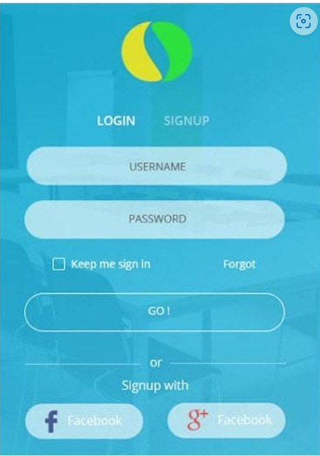
LOGIN PAGE

Slide 8
Verify if a user can log in with a valid username and password.
Verify if a user cannot log in with an invalid username or password. Check permutation and combinations of this.
Verify the ‘Keep me Sign In’ option. If this check box is selected, then the user should not get logged out even after exiting the app.
Verify if this check box is not selected by default.
If the user has signed up with Facebook or social media, verify that the user can log in with those credentials or not.
Verify the Forgot password functionality.

Slide 9
CONCLUSON
The eSports industry is a highly complex environment that is continually evolving.Besides the risk of not having a solid business model, eSports organizations need to govern the risk concerning future developments related to franchising, new markets, new games, and an ongoing fragmentation of the eSports industry.The eSports industry will, despite any events, grow, though the composition of stakeholders may change.

Slide 10


